Slide 1
Graphs: Basics
1843
ORD
SFO
802
337
1743
LAX
1233
DFW

Slide 2
Real Life Examples
On-line/Off-line Social Network

Slide 3
Real Life Examples
Internet Connectivity

Slide 4
Real Life Examples
WebBlog Connections

Slide 5
Real Life Examples
Navigator

Slide 6
Other Applications
Electronic circuits
Printed circuit board
Integrated circuit
Transportation networks
Highway network
Flight network
Computer networks
Local area network
Internet
Web
Databases
Entity-relationship diagram

Slide 7
Graphs
A graph is a pair (V, E), where
V is a set of nodes, called vertices
E is a collection of pairs of vertices, called edges
Vertices and edges are positions and store elements
Example:
A vertex represents an airport and stores the three-letter airport code
An edge represents a flight route between two airports and stores the mileage of the route
849
PVD
1843
ORD
142
SFO
802
LGA
337
1743
1387
HNL
2555
1099
LAX
1233
DFW
1120
MIA

Slide 8
Edge Types
Directed edge
ordered pair of vertices (u,v)
first vertex u is the origin
second vertex v is the destination
e.g., a flight
Undirected edge
unordered pair of vertices (u,v)
e.g., a flight route
Directed graph
all the edges are directed
e.g., route network
Undirected graph
all the edges are undirected
e.g., flight network
flight
AA 1206
ORD
PVD
849
miles
ORD
PVD

Slide 9
Terminology
End vertices (or endpoints) of an edge
U and V are the endpoints of a
Edges incident on a vertex
a, d, and b are incident on V
Adjacent vertices
U and V are adjacent
Degree of a vertex
X has degree 5
Parallel edges
h and i are parallel edges
Self-loop
j is a self-loop
V
a
b
h
j
U
d
X
Z
c
e
i
W
g
f
Y

Slide 10
Terminology (cont.)
Path
sequence of alternating vertices and edges
begins with a vertex
ends with a vertex
each edge is preceded and followed by its endpoints
Simple path
path such that all its vertices and edges are distinct
Examples
P₁=(V,b,X,h,Z) is a simple path
P₂=(U,c,W,e,X,g,Y,f,W,d,V) is a path that is not simple
V
a
b
P₁
d
U
X
Z
P₂
h
c
e
W
g
f
Y

Slide 11
Terminology (cont.)
Cycle
circular sequence of alternating vertices and edges
each edge is preceded and followed by its endpoints
Simple cycle
cycle such that all its vertices and edges are distinct
Examples
C₁=(V,b,X,g,Y,f,W,c,U,a,↵) is a simple cycle
C₂=(U,c,W,e,X,g,Y,f,W,d,V,a,↵) is a cycle that is not simple
Note) Tree is a graph without cycles
V
a
b
d
U
X
Z
C₂
h
e
C₁
c
W
g
f
Y

Slide 12
Subgraphs
A subgraph S of a graph G is a graph such that
The vertices of S are a subset of the vertices of G
The edges of S are a subset of the edges of G
A spanning subgraph of G is a subgraph that contains all the vertices of G
Subgraph
Spanning subgraph

Slide 13
Connectivity
A graph is connected if there is a path between every pair of vertices
A connected component of a graph G is a maximal connected subgraph of G
“Maximal”?
Connected graph
Non connected graph with two connected components

Slide 14
Trees and Forests
A (free) tree is an undirected graph T such that
T is connected
T has no cycles
This definition of tree is different from the one of a rooted tree
A forest is an undirected graph without cycles
The connected components of a forest are trees
Tree
Forest

Slide 15
Spanning Trees and Forests
A spanning tree of a connected graph is a spanning subgraph that is a tree
A spanning tree is not unique unless the graph is a tree
Spanning trees have applications to the design of communication networks
A spanning forest of a graph is a spanning subgraph that is a forest
Graph
Spanning tree

Slide 16
Some Properties for Undirected Graphs
Property 1
Σ_{v} deg(v) = 2m
Proof: each edge is counted twice
Property 2
In an undirected graph with no self-loops and no multiple edges
m ≤ n (n − 1)/2
Proof: each vertex has degree at most (n − 1)
What is the bound for a directed graph?
Notation
n number of vertices
m number of edges
deg(v) degree of vertex v
Example
n = 4
m = 6
deg(v) = 3

Slide 17
Main Methods of the Graph ADT
Vertices and edges
are positions
store elements
Accessor methods
e.endVertices(): a list of the two endvertices of e
e.opposite(v): the vertex opposite of v on e
u.isAdjacentTo(v): true iff u and v are adjacent
*v: reference to element associated with vertex v
*e: reference to element associated with edge e
Update methods
insertVertex(o): insert a vertex storing element o
insertEdge(v, w, o): insert an edge (v,w) storing element o
eraseVertex(v): remove vertex v (and its incident edges)
eraseEdge(e): remove edge e
Iterable collection methods
incidentEdges(v): list of edges incident to v
vertices(): list of all vertices in the graph
edges(): list of all edges in the graph

Slide 18
What is a data structure to represent a graph?
We will discuss three ways

Slide 19
1. Edge List Structure
Vertex object
element
reference to position in vertex sequence
Edge object
element
origin vertex object
destination vertex object
reference to position in edge sequence
Vertex sequence (e.g., list)
sequence of vertex objects
Edge sequence (e.g., list)
sequence of edge objects
u
a
c
b
d
v
w
z
u
v
w
z
a
b
c
d
Notes:
특정 노드의 incident edge를 보기 위해서는 edge를 모두봐야 한다. 그리고, 어떤 node가 어떤 node가 incident관계에 있는지를 보기 위해서는 모든 edge를 다 살펴봐야 한다.

Slide 20
Performance
n vertices, m edges no parallel edges no self-loops | Edge List | Adjacency List | Adjacency Matrix
Space | n + m | n + m | n²
v.incidentEdges() | m | deg(v) | n
u.isAdjacentTo (v) | m | min(deg(v), deg(w)) | 1
insertVertex(o) | 1 | 1 | n²
insertEdge(v, w, o) | 1 | 1 | 1
eraseVertex(v) | m | deg(v) | n²
eraseEdge(e) | 1 | 1 | 1
v.incidentEdges() and u.isAdjacneTo(v)
Need to check all the edges

Slide 21
2. Adjacency List Structure
Basic: Edge list structure
Supports direct access to the incident edges from a node
Incidence edge sequence for each vertex
Augmented edge objects
references to associated positions in incidence sequences of end vertices
Provides direct access
From the edges to the vertices
From the vertices to their incident edges
a
v
b
u
w
u
v
w
a
b
Notes:
특정 edge를 어떤 node들이 만들고 있는가를 포함시켜 준다. U와 V가 incident하고 있는지를 check하기 위해서는 U와 연결된 애들 또는 V가 연결된 애들만 접근하면 된다.

Slide 22
Performance
n vertices, m edges no parallel edges no self-loops | Edge List | Adjacency List | Adjacency Matrix
Space | n + m | n + m | n²
v.incidentEdges() | m | deg(v) | n
u.isAdjacentTo (v) | m | min(deg(v), deg(w)) | 1
insertVertex(o) | 1 | 1 | n²
insertEdge(v, w, o) | 1 | 1 | 1
eraseVertex(v) | m | deg(v) | n²
eraseEdge(e) | 1 | 1 | 1
v.incidentEdges(): direct access to incident edges
u.isAdjacentTo(v):

Slide 23
3. Adjacency Matrix Structure
Edge list structure
Augmented vertex objects
Integer key (index) associated with vertex
2D-array adjacency array
Reference to edge object for adjacent vertices
Null for non nonadjacent vertices
The “old fashioned” version just has 0 for no edge and 1 for edge
a
v
b
u
w
0
u
1
v
2
w
 | 0 | 1 | 2
0 | ∅ |  | ∅
1 |  | ∅
2 | ∅ |  | ∅
a
b
Notes:
어떤 노드들이 연결되어 있는가를 2-D array adjacency matrix로 만들어 놓는다. 연결된 경우에는 해당 edge로의 pointer연결을 한다.
Vertex를 insert를 할때, n^2이다. 왜일까? Memory reallocation?

Slide 24
Performance
n vertices, m edges no parallel edges no self-loops | Edge List | Adjacency List | Adjacency Matrix
Space | n + m | n + m | n²
v.incidentEdges() | m | deg(v) | n
u.isAdjacentTo (v) | m | min(deg(v), deg(w)) | 1
insertVertex(o) | 1 | 1 | n²
insertEdge(v, w, o) | 1 | 1 | 1
eraseVertex(v) | m | deg(v) | n²
eraseEdge(e) | 1 | 1 | 1
v.incidentEdges(): matrix row check
u.isAdjacentTo(v): using v’s key

Slide 25
Performance
n vertices, m edges no parallel edges no self-loops | Edge List | Adjacency List | Adjacency Matrix
Space | n + m | n + m | n²
v.incidentEdges() | m | deg(v) | n
u.isAdjacentTo (v) | m | min(deg(v), deg(w)) | 1
insertVertex(o) | 1 | 1 | n²
insertEdge(v, w, o) | 1 | 1 | 1
eraseVertex(v) | m | deg(v) | n²
eraseEdge(e) | 1 | 1 | 1
v.incidentEdges(): direct access to incident edges
u.isAdjacentTo(v):

Slide 26
Depth-First Search
A
B
D
E
C

Slide 27
Depth-First Search
Depth-first search (DFS) is a general technique for traversing a graph
Why is this traversal important?
Let’s first see the example
A
B
D
E
C

Slide 28
Example
A
unexplored vertex
A
A
visited vertex
B
D
E
unexplored edge
discovery edge
C
back edge
A
A
B
D
E
B
D
E
C
C

Slide 29
Example (cont.)
A
A
B
D
E
B
D
E
C
C
A
A
B
D
E
B
D
E
C
C
One implication: discovery edges form a spanning tree.

Slide 30
Depth-First Search
A DFS traversal of a graph G
Visits all the vertices and edges of G
Determines whether G is connected (how?)
Computes the connected components of G (how?)
Computes a spanning forest of G
DFS on a graph with n vertices and m edges takes O(n + m ) time
DFS can be further extended to solve other graph problems
Find and report a path between two given vertices
Find a cycle in the graph

Slide 31
DFS Algorithm
The algorithm uses a mechanism for setting and getting “labels” of vertices and edges
Algorithm DFS(G, v)
Input graph G and a start vertex v of G
Output labeling of the edges of G in the connected component of v as discovery edges and back edges
v.setLabel(VISITED)
for all e ∈ G.incidentEdges(v)
if e.getLabel() = UNEXPLORED
w ← e.opposite(v)
if w.getLabel() = UNEXPLORED
e.setLabel(DISCOVERY)
DFS(G, w)
else
e.setLabel(BACK)
Algorithm DFS(G)
Input graph G
Output labeling of the edges of G as discovery edges and back edges
for all u ∈ G.vertices()
u.setLabel(UNEXPLORED)
for all e ∈ G.edges()
e.setLabel(UNEXPLORED)
for all v ∈ G.vertices()
if v.getLabel() = UNEXPLORED
DFS(G, v)

Slide 32
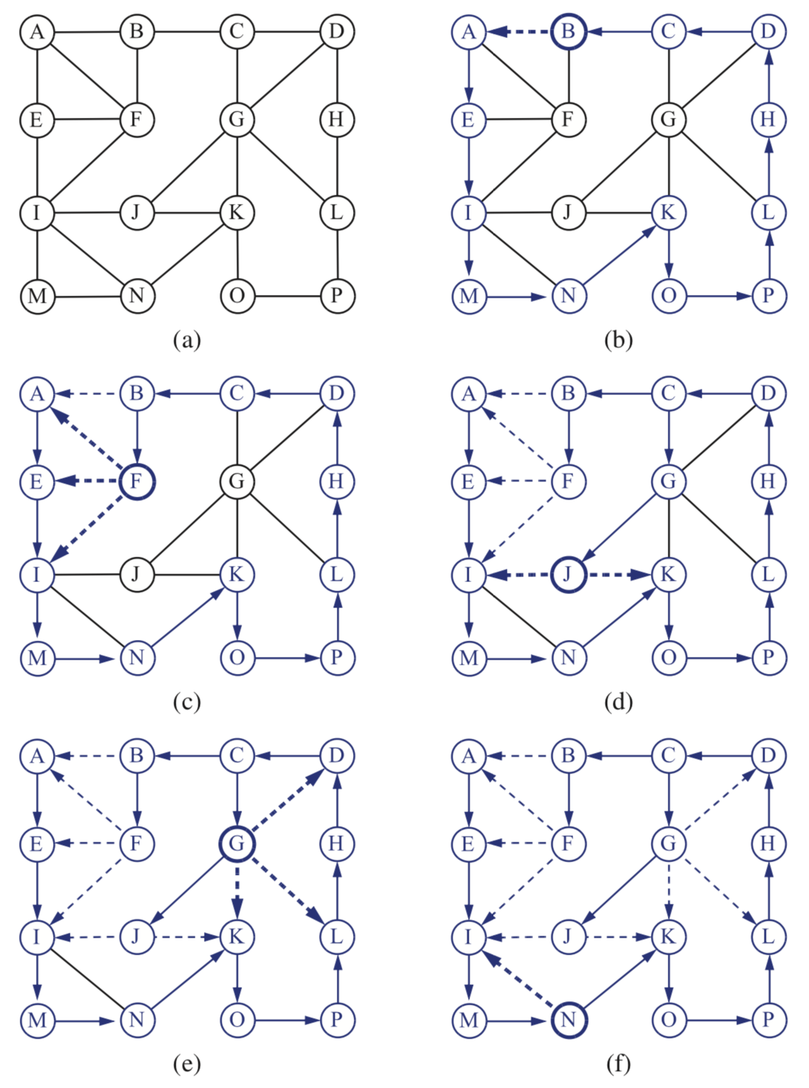

Slide 33
DFS and Maze Traversal
The DFS algorithm is similar to a classic strategy for exploring a maze
We mark each intersection, corner and dead end (vertex) visited
We mark each corridor (edge) traversed
We keep track of the path back to the entrance (start vertex) by means of a rope (recursion stack)

Slide 34
Properties of DFS
Property 1
DFS(G, v) visits all the vertices and edges in the connected component of v
Property 2
The discovery edges labeled by DFS(G, v) form a spanning tree of the connected component of v
A
B
D
E
C

Slide 35
Analysis of DFS
Setting/getting a vertex/edge label takes O(1) time
Each vertex is labeled twice
once as UNEXPLORED
once as VISITED
Each edge is labeled twice
once as UNEXPLORED
once as DISCOVERY or BACK
Method incidentEdges is called once for each vertex
Complexity of v.incidentEdges: deg(v)
DFS runs in O(n + m) time provided the graph is represented by the adjacency list structure
Recall that Σ_{v} deg(v) = 2m

Slide 36
Path Finding
We can specialize the DFS algorithm to find a path between two given vertices u and z using the template method pattern
We call DFS(G, u) with u as the start vertex
We use a stack S to keep track of the path between the start vertex and the current vertex
As soon as destination vertex z is encountered, we return the path as the contents of the stack
Algorithm pathDFS(G, v, z)
v.setLabel(VISITED)
S.push(v)
if v = z
return S.elements()
for all e ∈ v.incidentEdges()
if e.getLabel() = UNEXPLORED
w ← e.opposite(v)
if w.getLabel() = UNEXPLORED
e.setLabel(DISCOVERY)
S.push(e)
pathDFS(G, w, z)
S.pop(e)
else
e.setLabel(BACK)
S.pop(v)

Slide 37
Cycle Finding
We can specialize the DFS algorithm to find a simple cycle using the template method pattern
We use a stack S to keep track of the path between the start vertex and the current vertex
As soon as a back edge (v, w) is encountered, we return the cycle as the portion of the stack from the top to vertex w
Algorithm cycleDFS(G, v, z)
v.setLabel(VISITED)
S.push(v)
for all e ∈ v.incidentEdges()
if e.getLabel() = UNEXPLORED
w ← e.opposite(v)
S.push(e)
if w.getLabel() = UNEXPLORED
e.setLabel(DISCOVERY)
pathDFS(G, w, z)
S.pop(e)
else
T ← new empty stack
repeat
o ← S.pop()
T.push(o)
until o = w
return T.elements()
S.pop(v)

Slide 38
Breadth-First Search
L₀
A
L₁
B
C
D
L₂
E
F

Slide 39
Breadth-First Search
Breadth-first search (BFS) is another general technique for traversing a graph
Let’s look at the example

Slide 40
Example
L₀
unexplored vertex
A
A
A
visited vertex
L₁
B
C
D
unexplored edge
discovery edge
E
F
cross edge
L₀
L₀
A
A
L₁
L₁
B
C
D
B
C
D
E
F
E
F

Slide 41
Example (cont.)
L₀
L₀
A
A
L₁
L₁
B
C
D
B
C
D
L₂
E
F
E
F
L₀
L₀
A
A
L₁
L₁
B
C
D
B
C
D
L₂
L₂
E
F
E
F

Slide 42
Example (cont.)
L₀
L₀
A
A
L₁
L₁
B
C
D
B
C
D
L₂
L₂
E
F
E
F
L₀
A
L₁
B
C
D
L₂
E
F

Slide 43
Breadth-First Search
A BFS traversal of a graph G
Visits all the vertices and edges of G
Determines whether G is connected
Computes the connected components of G
Computes a spanning forest of G
BFS on a graph with n vertices and m edges takes O(n + m ) time
BFS can be further extended to solve other graph problems
Find and report a path between two given vertices
Can label each vertex by the length of a shortest path (in terms of # of edges) from the start vertex s
Find a simple cycle, if there is one

Slide 44
BFS Algorithm
The algorithm uses a mechanism for setting and getting “labels” of vertices and edges
Algorithm BFS(G, s)
L₀ ← new empty sequence
L₀.insertBack(s)
s.setLabel(VISITED)
i ← 0
while ¬L_{i}.empty()
L_{i +1} ← new empty sequence
for all v ∈ L_{i}.elements() for all e ∈ v.incidentEdges()
if e.getLabel() = UNEXPLORED
w ← e.opposite(v)
if w.getLabel() = UNEXPLORED
e.setLabel(DISCOVERY)
w.setLabel(VISITED)
L_{i +1}.insertBack(w)
else
e.setLabel(CROSS)
i ← i +1
Algorithm BFS(G)
Input graph G
Output labeling of the edges and partition of the vertices of G
for all u ∈ G.vertices()
u.setLabel(UNEXPLORED)
for all e ∈ G.edges()
e.setLabel(UNEXPLORED)
for all v ∈ G.vertices()
if v.getLabel() = UNEXPLORED
BFS(G, v)

Slide 45
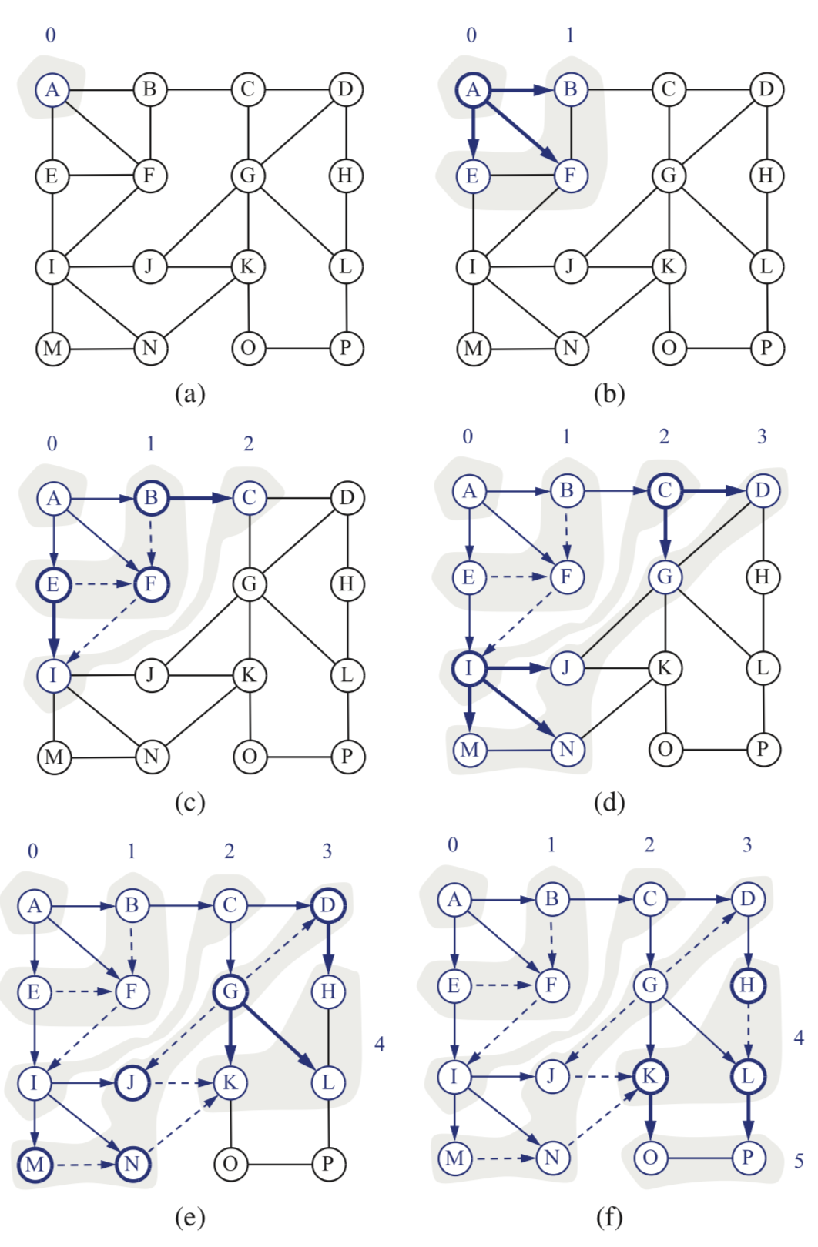

Slide 46
Properties
Notation
G_{s}: connected component of s
Property 1
BFS(G, s) visits all the vertices and edges of G_{s}
Property 2
The discovery edges labeled by BFS(G, s) form a spanning tree T_{s} of G_{s}
Property 3
For each vertex v in L_{i}
The path of T_{s} from s to v has i edges
Every path from s to v in G_{s} has at least i edges (i.e., find a shortest path)
A
B
C
D
E
F
L₀
A
L₁
B
C
D
L₂
E
F

Slide 47
Analysis
Setting/getting a vertex/edge label takes O(1) time
Each vertex is labeled twice
once as UNEXPLORED
once as VISITED
Each edge is labeled twice
once as UNEXPLORED
once as DISCOVERY or CROSS
Each vertex is inserted once into a sequence L_{i}
Method incidentEdges is called once for each vertex
BFS runs in O(n + m) time provided the graph is represented by the adjacency list structure
Recall that Σ_{v} deg(v) = 2m

Slide 48
Applications
Using the template method pattern, we can specialize the BFS traversal of a graph G to solve the following problems in O(n + m) time
Compute the connected components of G
Compute a spanning forest of G
Find a simple cycle in G, or report that G is a forest
Given two vertices of G, find a path in G between them with the minimum number of edges, or report that no such path exists

Slide 49
DFS vs. BFS
Applications | DFS | BFS
Spanning forest, connected components, paths, cycles | √ | √
Shortest paths |  | √
Biconnected components (how?) | √
Biconnected components:
Connected
Even after removing any vertex the graph remains connected
L₀
A
A
L₁
B
C
D
B
C
D
L₂
E
F
E
F
DFS
BFS

Slide 50
DFS vs. BFS (cont.)
Back edge (v,w)
w is an ancestor of v in the tree of discovery edges
Cross edge (v,w)
w is in the same level as v or in the next level
L₀
A
A
L₁
B
C
D
B
C
D
L₂
E
F
E
F
DFS
BFS

